Slide 1

Spring Batch
Dima Ionut Daniel

Slide 2
Contents
What is Spring Batch?
Features
Arhitecture
Core classes
Parallelization
Job Repository
Job Explorer / Job Operator
Job Launcher
Jobs
Job Listeners
Steps
Flows
Readers
Item Processors
Item Writers
ExecutionContext
Advanced topics
Conclusions
Bibliography

Slide 3

What is Spring Batch?
Spring Batch is an open source framework for batch processing.
Spring Batch builds upon the POJO-based development approach of the Spring Framework.
Spring Batch is part of the Spring Portfolio.

Slide 4
Features
Spring Batch main features:
Defining Jobs with Spring: a job is a process that consists of a number of steps.
Managing Jobs: maintains data integrity when a job fails
Local and Remote Parallelization: parallel chunk/step processing, partitioning
Standardizing I/O: reading complex files, XML files, DB, etc

Slide 5
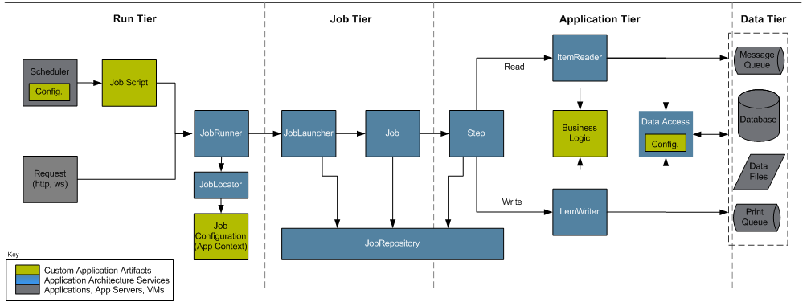
Arhitecture
Spring Batch framework contains:
the application layer - code to develop(interfaces with core layer)
the core layer (actual components)
and the infrastructure layer (writers/readers)

Slide 6
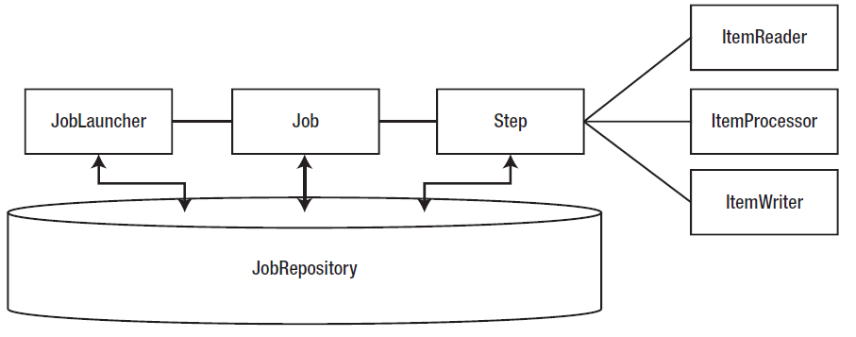
Arhitecture
JobRepository is used to persist information about job and step executions.
The JobExecution/StepExecution contains information about a single run of the job/step.
Running a job begins with the JobLauncher. It verifies the job(parameters/state) before running it.

Slide 7
Core Classes
org.springframework.batch.core.Job: represents the job.
org.springframework.batch.core.Step: represents a step.
org.springframework.batch.item.ItemReader<T>: provides the ability to input items.
org.springframework.batch.item.ItemProcessor<T>: applies business logic to an individual item as provided.
org.springframework.batch.item.ItemWriter<T>: provides the ability to output a list of items.
A job is a collection of steps . Each step has up to three parts: an ItemReader, an ItemProcessor, and an ItemWriter. A step isn’t required to have an ItemProcessor.

Slide 8
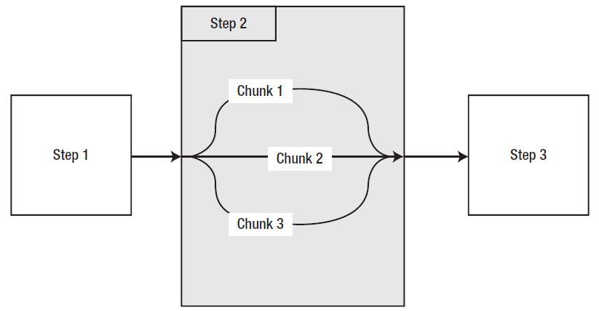
Parallelization
There are 4 ways of parallelization:
multithreaded steps
parallel execution of full steps
remote chunking
partition
Multithreaded Steps
a job is configured to process work in blocks called chunks, with a commit after each block
the processing is done in series.
We can use 3 threads to process the chunks.

Slide 9
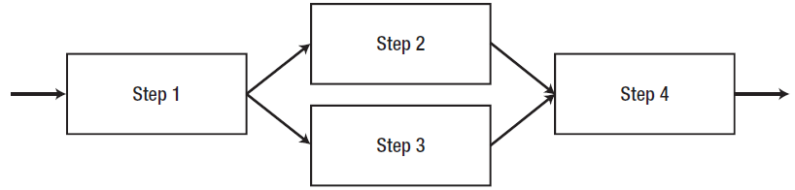
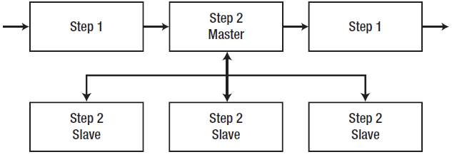
Parallelization (cont.)
Parallel Steps
if there are no dependencies between the steps we can execute them in parallel
Remote Chunking
the input is performed using a ItemReader in master node and sent to remote slave ItemProcessor.
Partitioning
is a master/slave configuration.
the slave steps receive their work from the master node instead of the job itself.
there is no need for durable communication with guaranteed delivery

Slide 10
Job Repository
Spring Batch is configured to use HSQLDB by default.
To change this configuration we need to change the data source configuration and the batch schema in the DB.
Spring Batch uses databases to maintain its state and uses 6 tables.
BATCH_JOB_INSTANCE
an instance of job.
BATCH_JOB_PARAMS
parameters that run with the job.
BATCH_JOB_EXECUTION
contains the state of job executions.
BATCH_JOB_EXECUTION_CONTEXT
BATCH_STEP_EXECUTION
contains the state of job executions.
BATCH_STEP_EXECUTION_CONTEXT

Slide 11
Job Repository (cont.)
Spring Batch maintains the state using job repository.
To configure in-memory repository we use MapJobRepositoryFactoryBean.
To configure persistent repository we use JobRepositoryFactoryBean.
For every configuration a transaction manager is required due to JobRepository operations.
If we want to use a dummy transaction manager we can use ResourcelessTransactionManager.

Slide 12
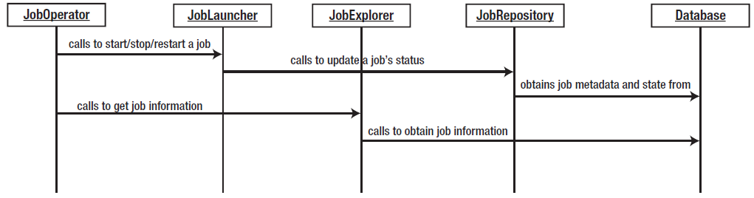
Job Explorer / Job Operator
JobExplorer interface is the entry point to access the historical and active data in the job repository.
JobExplorer provides has read-only access to data and has 7 methods to achieve this task:
-findRunningJobExecutions, getJobExecution, getJobExecutions, getJobInstance
-getJobInstance, getJobInstances, getJobNames, getStepExecution
JobExplorer is configured using a DataSource dependency.
The JobOperator interface allows the execution of basic administrative tasks programmatically in a job.
This interface contains 11 methods: getParameters, restart, start, startNextInstance, stop, etc.

Slide 13
Job Launcher
JobLauncher is responsable for starting a job, exposing any number of execution options(web,JMX,cmd,etc).
SimpleJobLauncher uses Spring’s SyncTaskExecutor, which executes the job in the current thread.
Spring batch provides 2 runners:
CommandLineJobRunner:
JobRegistryBackgroundJobRunner
CommandLineJobRunner parameters: - jobPath, -restart, -stop, -abandon, -next, etc.
JobRegistryBackgroundJobRunner is intended to bootstrap Spring and build a JobRegistry for others to consume.

Slide 14
Jobs
A job represents a collections of actions(flow).
In Spring batch the jobs are configured via XML.
The execution of a job begins with a job runner. Spring batch provides 2 job runners:
CommandLineJobRunner: intended to run from a script of from command line.
JobRegistrybackgroundJobRunner: used for scheduling(Quartz) of JMX.
The application entrypoint is the JobLauncher interface.
When a batch job is run a JobInstance is created.
Jobs can use inheritance for:
ability to restart a job
job listeners
validator
JobParametersValidator is used to validate job parameters.

Slide 15
Jobs (cont.)
There is a limitation that a job can only be run once with a given set of parameters.
JobParametersIncrementer allows to uniquely generate parameters for a given job.
This will add a long parameters named default with run.id that will be unique on every run.
The job runner needs to be called with "-next" in the end.
We can create custom implementation using JobParametersIncrementer.
A job runs all all its steps until the status returned is COMPLETED.

Slide 16
Jobs (cont.)
We can force Spring Batch to terminate step execution using execution.setTerminateOnly() using StepListener with @AfterStep.
Also we can change the ExitStatus of a step using the StepListener.
The default behaviour for Spring Batch is that all jobs can be executed if they fail or are stoped.
The “restartable “ attribute of job tag flags the job if it can be restarted.
The "start-limit" attribute indicates the maxim number a job can be restarted. When the number defined is exceeded the StartLimitExceededException is thrown.
We can rerun a successful step using "allow-start-if-complete".

Slide 17
Job Listeners
There are 2 ways to create a job listener:
implementing JobExecutionListener (beforeJob, afterJob)
using annotations: @BeforeJob, @AfterJob
We can use use listener inheritance when defining jobs.

Slide 18
Steps
A step:
is the building block of a job.
represents a sequential batch processor.
contains all pieces a job requires.
contains an input and output.
Batch processes in general are about processing data.
There are 2 options for processing data:
Individual item
Chunk of items

Slide 19
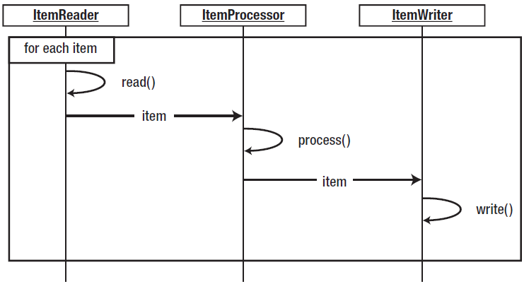
Steps (cont.)
Item-based processing is done as:
Reading items
Processing items
Writing output
Item-based processing was introduced in Spring Batch 1.x and was the only way records were processed.

Slide 20
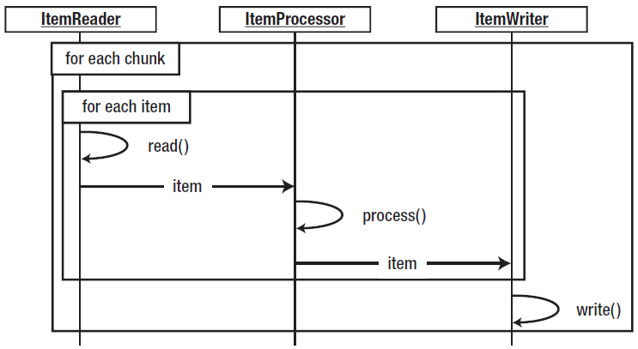
Steps (cont.)
A chunk represents a subset of records that need to be processed.
In Spring Batch we can define the number of rows that are processed between each commit.
Performance gains can be achieved using this process capability.
Spring Batch 2 introduced the concept of chunk-based processing.

Slide 21
Steps (cont.)
There are 2 different step types:
step for chunk-based processing
tasklet step
Chunks are defined by their commit intervals.
If we configure within the <tasklet> tag the tag <chunk> the ChunkOrientedTasklet is used.
Spring Batch provides three other implementations of the Tasklet interface:
CallableTaskletAdapter
allows you to configure an implementation of the Callable<RepeatStatus> interface.
MethodInvokingTaskletAdapter
allows to execute a preexisting method on another class.
SystemCommandTasklet
executes a system command asynchronously

Slide 22
Steps (cont.)
Like jobs, steps can be inherited from each other.
Chunk configuration:
static commit count
CompletionPolicy implementation
CompletionPolicy inteface
isComplete
start - resets internal state
update - called once for each item that has been processed to update the internal state.
Step listeners cover the same types of events (start and end).
StepExecutionListener: beforeStep/afterStep
ChunkListener: beforeChunk/afterChunk
The next tag uses on attribute to evaluate the ExitStatus of the step.
Another alternative is o use the tag decision with JobExecutionDecider implementation.

Slide 23
Steps (cont.)
There are 3 states how a job can finish:
Completed
Failed: can be rerun with the same parameters
Stopped: can be restarted
The end tag can be used to end a job based on the exit status of a step.
The fail state allows to rerun the job with the same parameters.
The stop tag is used to identify where to continue when the job is restarted.

Slide 24
Flows
A flow looks a lot like a job configured with a flow tag instead of a job tag.
In Spring Batch, there are 3 options for how to externalize the order of steps.
create a flow, which is an independent sequence of steps (flow tag).
usage of flow step (flow inside a step tag).
call another job from within your job.
Spring Batch can execute steps in parallel using split tag.

Slide 25
Readers
Each step consists of an ItemReader, an ItemProcessor, and an ItemWriter.
The ItemReader interface has the read() method that is used to provide input for a step.
Spring Batch provides implementations for: flat file, DB, JMS, etc.
FlatFileItemReader consists in:
Spring Resource:
LineTokenizer: parses the line into FieldSet.
FieldSetMapper: maps FieldSet to a domain object.
LineMapper
LineMapper is used to retrieve the lines and contains the mapLine() method.
Example impl: DelimitedLineTokenizer, FixedLengthTokenizer, RegexLineTokenizer, PatternMatchingCompositeLineMapper.
LineTokenizer split a line into tokens and contains tokenize() method.
Example impl: DelimitedLineTokenizer, FixedLengthTokenizer, RegexLineTokenizer.
FieldSetMapper contains the mapFieldSet() method.
Example impl: ArrayFieldSetMapper, BeanWrapperFieldSetMapper, PassThroughFieldSetMapper.

Slide 26
Readers (cont.)
To parse XML input files, String Batch uses StaxEventItemReader.
We need to configure the root elements and an Unmarshaller implementation to convert the XML to domain object.
Spring Batch provides 2 methods for loading records:
cursor: default functionality of the JDBC ResultSet
paging: retrieves records in chunks called pages.
JdbcCursorItemReader is used to read JDBC data using cursor and map rows to domain object. It needs a DataSource, a query to run and a RowMapper implementation.
If we want to pass parameters to SQL we use the PreparedStatementSetter.
JdbcPagingItemReader is used for paginations where the result set is returned in chunks called pages. Unfortunately, each DB offers its own paging implementation.
JmsItemReader is used to read from a JMS queue and needs: queue, connection factory, JmsTemplate.

Slide 27
Readers (cont.)
HibernateCusorItemReader is used when using Hibernate to read records from DB.
For using Hibernate we need to configure:
sessionFactory (ex: LocalSessionFactoryBean)
transactionManager (ex:HibernateTransactionManager)
HibernatePagingItemReader is used to read data with pagination.
To configure JPA we need
setup persitence.xml.
transactionManager: JpaTransactionManager
entityManagerFactory: LocalContainerEntityManagerFactoryBean
The JobRepository needs to be configured to have an isolation level.
JpaPagingItemReader is used for reading DB data.

Slide 28
Readers (cont.)
When any error occurs during the reading process, Spring Batch throws an exception.
We can specify what exceptions to skip with "skippable-exception-classes" tag and how times with "skip-limit" attribute.
Spring Batch provides the SkipPolicy interface with the method shouldSkip().
ItemReadListener is useful when reading items and contains methods like: beforeRead, afterRead, and onReadError.

Slide 29
Item Processors
Spring Batch provides utility ItemProcessors like the ItemProcessorAdapter.
ItemProcessor contains the process() method.
ValidatingItemProcessor is a ItemProcessor implementation for validating input.
We can use JSR 303 validations by implementing Spring Validator and using annotations.
CompositeItemProcessor can be used to create a chain of item processors.

Slide 30
Item Writers
Spring Batch uses ItemWriters as output mechanism. The ItemWriter interface contain the write() method.
FlatFileItemWriter can be used to generate text file to output and needs:.
Resource: the output file
LineAggregator: Examples: PassThroughLineAggregator, FormatterLineAggregator, DelimitedLineAggregator
FieldExtractor is used to convert a domain object to an array of objects.
FlatFileItemWriter options:
shouldDeleteIfEmpty: deletes the file if nothing was written.
shouldDeleteIfExists: deletes the same named existent file.
appendAllowed: appends data.
StaxEventItemWriter is used to write XML files.

Slide 31
Item Writers (cont.)
JdbcBatchItemWriter is used to write data to DB and has following options:
assertUpdates: validates that operation was sucess.
itemPreparedStatementSetter: binds parameters to SQL
sql: sql string
HibernateItemWriter is like a wrapper for HibernateTemplate.
JpaItemWriter is like a wrapper for EntityManager.
ItemWriterAdapter requires a targetObject and a targetMethod for configuration.
JmsItemWriter is used to write to a JMS queue and needs: queue, connection factory, JmsTemplate.
CompositeItemWriter can be used to create a chain of item writers.
SimpleMailMessageItemWriter can be used to send mails when the job is done.
ClassifierCompositeItemWriter allows to write items based on a predetermined criteria.

Slide 32
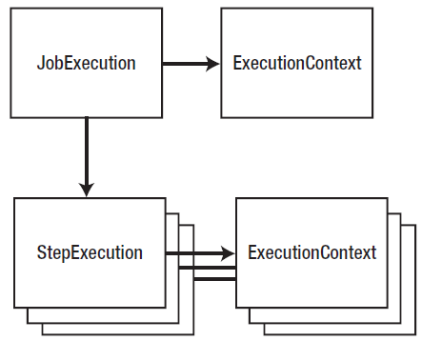
Advanced topics
Retry logic in Spring Batch is implemented as:
configuring retry attempts(define retry number + exceptions)
using RetryTemplate
using Spring AOP feature
Items that causes problems can be skipped.
Batch processes are stateful using the ExecutionContext.
The ExecutionContext is part of the JobExecution or StepExecution.

Slide 33
Conclusions
PROS:
Lightweight Spring based framework

Slide 34

Bibliography
http://en.wikipedia.org/wiki/Spring_Batch
http://static.springsource.org/spring-batch/trunk/spring-batch-core/
Apress – Pro Spring Batch – July 2011

